Slide 1
GitHub Actions
Overview
Practical Examples

Slide 2
GitHub Actions - Overview
GitHub Actions is a CI/CD automation platform
  CI = Continuous Integration
  CD = Continuous Delivery
  Not just for building code: anything on GitHub can be automated
    Pull requests, Issues, Pages, Deployment, …
Core concept: “workflow”
  Triggers: When X happens…
  … do something
Similar to other CI/CD platforms (usually called pipelines):
  GitLab – Pipeline
  Jenkins - Pipeline
  Travis - Pipeline
  Azure DevOps - Pipeline
  AWS CodePipeline
  Atlassian Bamboo

Slide 3
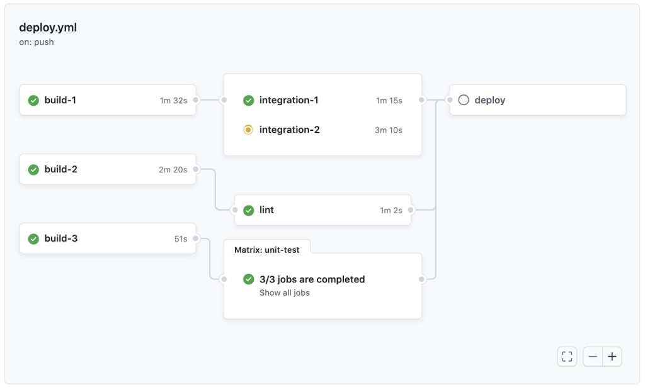
GitHub Actions - Terminology
GitHub Actions is the name of the platform
A workflow is a complete description of a set of work to perform when triggered (a.k.a. pipeline in other systems)
  Workflows can be reusable (called from other repositories/workflows)
A job is a unit of work inside a workflow
  Jobs run in parallel, and can have dependencies
Jobs consist of steps
Steps can be shell scripts or (reusable) actions
  Yes, this is confusing…
  There is a large ecosystem of reusable actions

Slide 4
GitHub Actions – Simple Example
[ Example 1: https://github.com/dvnrrs/github-actions-demo/blob/main/.github/workflows/1-build-myprogram.yml ]

Slide 5
GitHub Actions – Runners
By default, GitHub cloud runners are used.
  Examples:
    runs-on: ubuntu-latest
    runs-on: ubuntu-latest-8-cores
    runs-on: windows-2019
    runs-on: macos-14-large
  Personal accounts (and paid ones) get a quota of public runner minutes.
  “Large runners” must be enabled, and cost more.
On-premises (self-hosted) runners can also be used.
  runs-on:
    group: fusion-devops-linux
In both cases, Docker containers can be used.
  container: ghcr.io/blueberrydaq/buildroot-builder:2.9
  The repository must have permission to access the container.

Slide 6
GitHub Actions - Triggers
push – Runs when a commit or tag is pushed to a repository.
  branches: [main, release/**]
pull_request - Runs when a pull request is created or modified.
  types: [opened, reopened]
workflow_dispatch – Runs when manually triggered from the GitHub UI.
workflow_call – Runs when called from another workflow (reusable workflow).
workflow_run – Runs when another workflow ends.
  workflows: [build]
  types: [completed]
schedule – Runs at specific times.
  - cron: '30 5,17 * * *'

Slide 7
GitHub Actions – Custom Actions
There is a large ecosystem of reusable actions.
You can create your own reusable action.
  Composite actions combine existing actions in a sequence, like a workflow.
  JavaScript actions are written using Node.js.
  Docker container actions are implemented with Docker images.
Actions can have inputs and outputs as well as side effects.
[ Example 2: https://github.com/dvnrrs/github-actions-demo/blob/main/.github/workflows/2-build-myprogram-with-reusable-action.yml ]
[ JavaScript Example: https://github.com/blueberrydaq/git-version-action ]

Slide 8
GitHub Actions – Reusable Workflows
A reusable workflow is simply a workflow with a workflow_call trigger.
Like actions, reusable workflows can have inputs and outputs as well as side effects.
Reusable workflows can be in another repository.
  The calling workflow must have permission to access the called workflow.
[ Example 3: https://github.com/dvnrrs/github-actions-demo/blob/main/.github/workflows/3-reusable-build.yml ]
[ Example 4: https://github.com/dvnrrs/github-actions-demo/blob/main/.github/workflows/4-build-myprogram-with-reusable-workflow.yml ]

Slide 9
GitHub Actions - Artifacts
Artifacts are files that can be uploaded by a job.
  They can later be downloaded by other jobs.
  They can also be downloaded from the website.
  They can also be downloaded using the “gh” CLI.
They are the primary method of sharing data between jobs.
Upload an artifact with the actions/upload-artifact action.
Download an artifact with the actions/download-artifact action.
[ Example 5: https://github.com/dvnrrs/github-actions-demo/blob/main/.github/workflows/5-automatic-release.yml ]

Slide 10
GitHub Actions - Matrices
A matrix can run multiple parallel instances of a job with varying parameters.
  The matrix defines the parameter values for each instance.
  Multiple covarying parameters can be defined.
[ Example 6: https://github.com/dvnrrs/github-actions-demo/blob/main/.github/workflows/6-matrices-and-concurrency.yml ]
[ Larger Example: https://github.com/hbkdaq/next-firmware/blob/master/.github/workflows/build-all-impl.yml ]

Slide 11
GitHub Actions – Concurrency Groups
Concurrency groups limit how many instances of a job or workflow can run at the same time.
Each concurrent job/workflow defines a group string. If two instances’ group strings evaluate to the same string, those instances are concurrent.
Default behavior is to wait for previous jobs/workflows to finish before starting another.
With cancel-in-progress, previous jobs/workflows can instead be cancelled to let the new one run. This is useful, for example, for pull request triggers – if the pull request is updated, a previously running build should be cancelled.

Slide 12
GitHub Actions – Secrets
Secrets are protected strings that can be accessed in a workflow via ${{ secrets.NAME }}.
Secrets are defined at the repository or organization scope.
GitHub aggressively strips secrets from logs.
Secrets can be inherited by invoked reusable workflows.

Slide 13
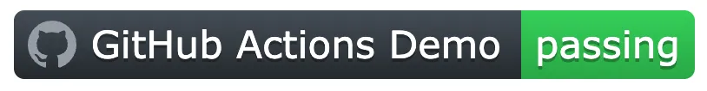
GitHub Actions – Badges
Badges are HTTP-fetchable SVG images that show the status of a workflow.
Construct a URL like:
  https://github.com/OWNER/REPOSITORY/actions/workflows/WORKFLOW-FILE/badge.svg
Example:
  https://github.com/hbkdaq/next-firmware/actions/workflows/nightly-release.yml/badge.svg

Slide 14
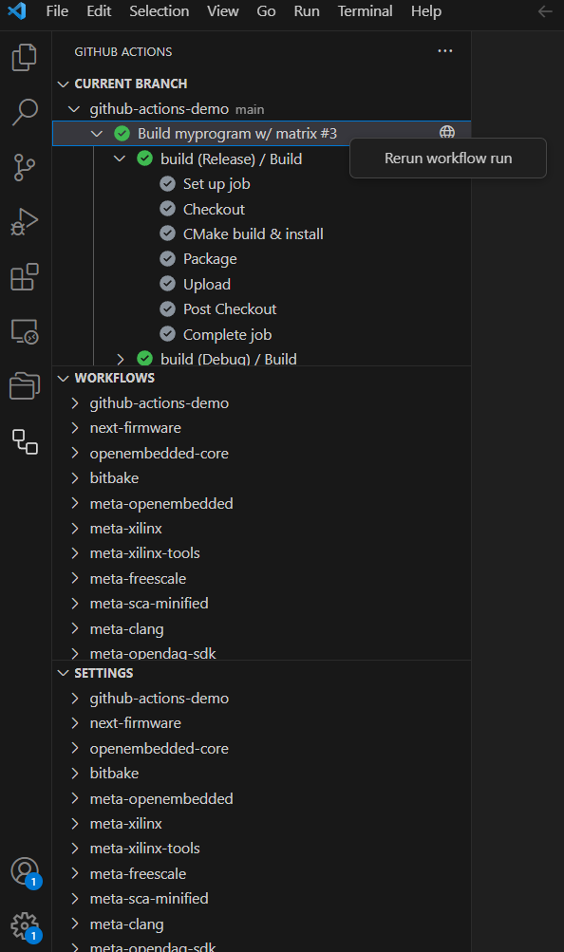
GitHub Actions – Visual Studio Code Integration
Official VS Code extension
[ Live demo ]

Slide 15
GitHub Actions – Questions?
Thanks for your time!

